Slide 1

Natural Language Processing
Co-reference Resolution
Mamatha.H.R
Department of Computer Science and Engineering

Slide 2

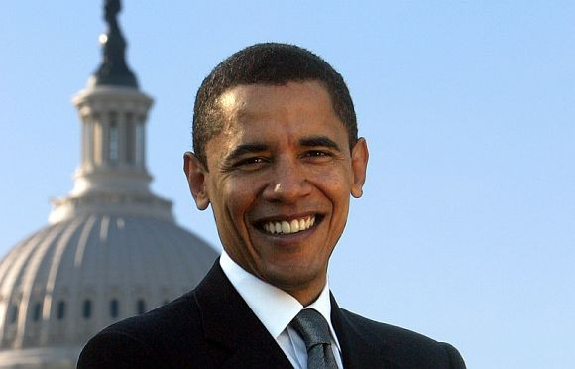
NATURAL LANGUAGE PROCESSING
Co-reference Resolution
Identify all Noun Phrases (mentions) that refer to the same real world entity
Barack Obama nominated Hillary Rodham Clinton as his secretary of state on Monday. He chose her because she had foreign aﬀairs experience as a former First Lady.
Barack Obama nominated Hillary Rodham Clinton as his secretary of state on Monday. He chose her because she had foreign aﬀairs experience as a former First Lady.
Mentions or Referring Expression

Slide 3
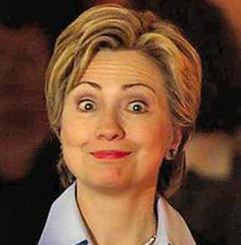
NATURAL LANGUAGE PROCESSING
Co-reference Resolution
Barack Obama nominated Hillary Rodham Clinton as his secretary of state on Monday. He chose her because she had foreign aﬀairs experience as a former First Lady.
Mentions or Referring Expression
Two or more referring expressions that are used to refer to the same discourse entity are said to corefer.

Slide 4
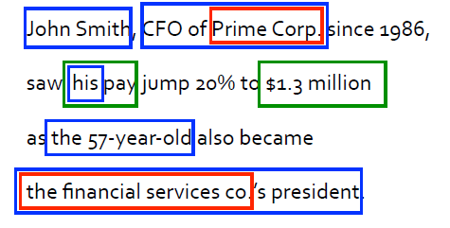
NATURAL LANGUAGE PROCESSING
Co-references
Noun phrases refer to entities in the world, many pairs of noun phrases co-refer some nested inside others

Slide 5
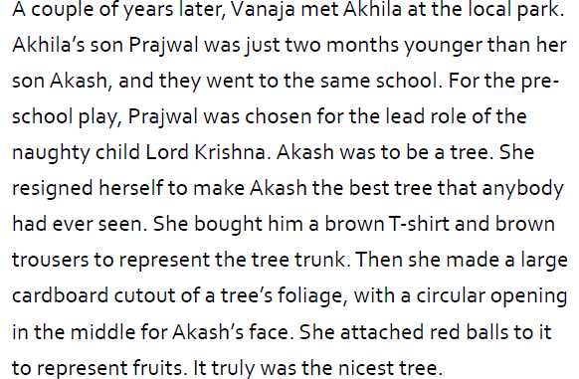
NATURAL LANGUAGE PROCESSING
Co-references
From The Star by Shruthi Rao, with some shortening

Slide 6
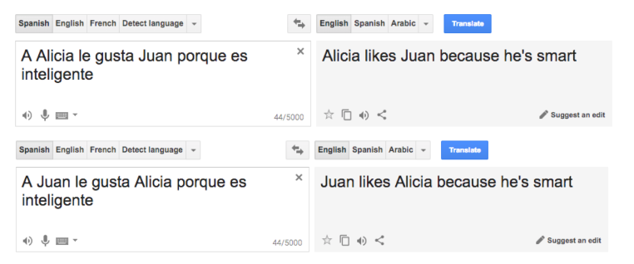
NATURAL LANGUAGE PROCESSING
Applications of Co-reference Resolution
For understanding the text completely co-reference resolution is important.
Information extraction, question answering, summarization, machine translation……
Just as an example of Machine Translation:

Slide 7
NATURAL LANGUAGE PROCESSING
Applications of Co-reference Resolution
Dialogue Systems
Person: “Book tickets to see James Bond”
System: “Spectre is playing near you at 2:00 and 3:00 today. System: How many tickets would you like?”
Person: “Two tickets for the showing at three”
Some more examples:
“She poured water from the pitcher into the cup until it was full”
“She poured water from the pitcher into the cup until it was empty”
The trophy would not fit in the suitcase because it was too big.
• The trophy would not fit in the suitcase because it was too small.

Slide 8
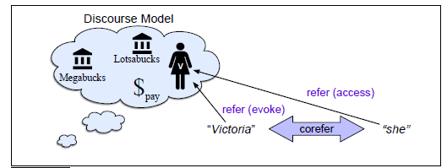
NATURAL LANGUAGE PROCESSING
Co-reference Resolution
NLU systems (and humans) interpret linguistic expressions wrt a discourse model.
A discourse model is a mental model that the understander(listener) builds incrementally when interpreting a text, containing representations of the entities referred to in the text, as well as properties of the entities and relations among them.
Victoria Chen, CFO of Megabucks Banking, saw her pay jump to $2.3 million, as the 38-year-old became the company’s president. It is widely known that she came to Megabucks from rival Lotsabucks.
When a referent is first mentioned in a discourse, we say that a representation for it is evoked into the model. Eg, when ‘Victoria Chen’ appeared for the 1st time in text, a representation is evoked into the model.
Upon subsequent mention, this representation is accessed from the model. Later when ‘she’ appears for Victoria Chen then representation for it is accesed from the model.
How mentions evoke and access discourse entities in a discourse model

Slide 9
NATURAL LANGUAGE PROCESSING
Anaphora
Anaphora:
Reference to an entity ‘Victoria Chen’ (like pronouns she and her and the definite NP the 38-year-old) that has been previously introduced into the discourse is called anaphora.
The referring expression ( ‘her’, ‘ she’ , ‘the 38-year-old’)used is an anaphor, or anaphoric.
The anaphor co-refers with a prior mention (in this case Victoria Chen) that is called the antecedent.
An entity that has only a single mention in a text (like Lotsabucks )is called a singleton.
Anaphors are mostly pronouns, or noun phrases in some cases.
Victoria Chen, CFO of Megabucks Banking, saw her pay jump to $2.3 million, as the 38-year-old became the company’s president. It is widely known that she came to Megabucks from rival Lotsabucks.
When two expressions are co-referential, the one is usually a full form (the antecedent) and the other is an abbreviated form (a proform or anaphor)
Like Victoria Chen is full form and she is abbreviated.

Slide 10














NATURAL LANGUAGE PROCESSING
Examples of Anaphora
Niall Ferguson is prolific, well-paid and a snappy dresser. Stephen Moss hated him — at least until he spent an hour being charmed in the historian’s Oxford study
Niall Ferguson is prolific, well-paid and a snappy dresser. Stephen Moss hated him — at least until he spent an hour being charmed in the historian’s Oxford study.
Darshan plays keyboard. He loves music”.
Darshan plays keyboard. He loves music (the anaphor “He” is a pronoun.)
A puppy drank the milk. The cute little dog was satisfied”.
“A puppy drank the milk. The cute little dog was satisfied”.
(the anaphor “The cute little dog” is a NP.)
Anaphora
Text
World
(Co)Reference
Text
World

Slide 11
NATURAL LANGUAGE PROCESSING
Examples of anaphora
Not all anaphoric relations are co-referential.
Eg,
We went to see a concert last night. The tickets were really expensive.
This is referred to as bridging anaphora.

Slide 12
NATURAL LANGUAGE PROCESSING
What is Co-reference Chain?
Determining whether two mentions co-refer, i.e. they refer to the same entity in the discourse model (the same discourse entity).
The set of co-referring expressions is often called a co-reference chain or a cluster.
A co-reference resolution algorithm must be able to find at least 4 co-reference chains, corresponding to the 4 entities in the discourse model as per the example:
1. {Victoria Chen, her, the 38-year-old, She}
2. {Megabucks Banking, the company, Megabucks}
3. {her pay}
4. {Lotsabucks}
An Important POINT: mentions can be nested
E.g. the mention ‘her’ is a part of another mention, ‘her pay’, referring to a completely different discourse entity.
Victoria Chen, CFO of Megabucks Banking, saw her pay jump to $2.3 million, as the 38-year-old became the company’s president. It is widely known that she came to Megabucks from rival Lotsabucks.

Slide 13
NATURAL LANGUAGE PROCESSING
Co-reference Resolution
Co-reference resolution thus comprises two tasks
Mentions identification
Making clusters of mentions or discourse entities

Slide 14
NATURAL LANGUAGE PROCESSING
Types of Referring expressions
Indefinite NP:
(i) Mrs. Martin was so very kind as to send Mrs. Goddard a beautiful goose.
(ii) He had gone round one day to bring her some walnuts.
(iii) I saw this beautiful cauliflower today.
a, some, this etc makes a NP indefinite
Definite NP:
(i) It concerns a white stallion which I have sold to an officer. But the pedigree
of the white stallion was not fully established.
Pronouns:
(i) Emma smiled and chatted as cheerfully as she could,
Pronouns can also be found as quantified contexts in which they are considered to be bound,
Eg. Every student got his result.
‘his’ is a bound.
Cataphora:
( referring expression appears before referent)
Even before she saw it, Dorothy had been thinking about the Emerald City every day.

Slide 15
NATURAL LANGUAGE PROCESSING
Types of Referring expressions
Demonstrative Pronouns:
this and that can appear either alone or as determiners.
Eg., I just bought a copy of Thoreau’s Walden. I had bought one five years ago.
That one had been very tattered; this one was in much better condition.
Zero Anaphora:
The zero anaphora creates an expectation that the listener will be able to infer who/what the speaker intends to identify.
Eg. Peel the onions and slice it. Drop them in the hot oil. φ Cook for 3 mins.
φ = onions
φ is missing but expected by listener to infer that “ onions” are being talked about.

Slide 16
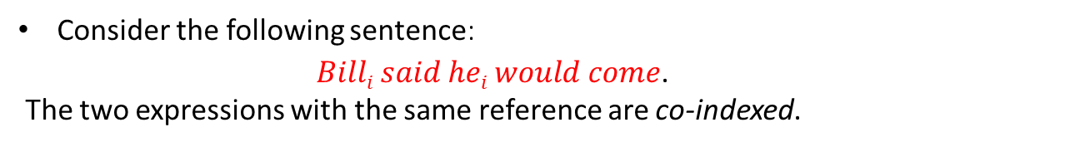

NATURAL LANGUAGE PROCESSING
Co-reference Resolution Formulation
Co-reference resolution can be formulated as follows:
Given a text T, find all entities and the co-reference links between them.
Then evaluate the task by comparing the links the system has created with those in human-created co-reference annotations on T.
1. {Victoria Chen, her, the 38-year-old, She}
2. {Megabucks Banking, the company, Megabucks}
3. {her pay}
4. {Lotsabucks}
In co-reference evaluation systems, the input to the system is the raw text of articles, and systems must detect mentions and then link them into clusters.
Superscript numbers are for each co-reference chain (cluster), and subscript letters for individual mentions in the cluster.

Slide 17

NATURAL LANGUAGE PROCESSING
Co-reference Resolution: Mention Detection
The first stage of co-reference is mention detection.
Finding the spans of text that constitute each mention.
Eg., Many systems run parsers and named entity taggers on the text and extract every span that is either an NP, a possessive pronoun, or a named entity.
A mention detection system might result in the following 13 mentions:
All such mention detection systems filter out pleonastic/ expletive pronouns like ‘It’ above, appositives like CFO of Megabucks Banking Inc, or predicate nominals like the company’s president or $2.3 million.
Victoria Chen, CFO of Megabucks Banking, saw her pay jump to $2.3 million, as the 38-year-old became the company’s president. It is widely known that she came to Megabucks from rival Lotsabucks.
An appositive is a noun or pronoun(often with modifiers) appears beside another noun or pronoun to explain or identify it. Eg. Your friend Bill is in trouble.

Slide 18
NATURAL LANGUAGE PROCESSING
Co-reference Resolution: Mention Detection
The filtering stated above can be done by rules.
Early rule-based systems used regular expressions to deal with pleonastic pronouns,
Rule-based systems are generally insufficient to deal with mention detection,
So modern systems incorporate learned mention detection component, such as a referentiality classifier,
an anaphoricity classifier— detecting whether an NP is an anaphor
or a discourse-new classifier— detecting whether a mention is discourse-new and a potential antecedent for a future anaphor.
An anaphoricity detector, can draw its positive training examples from any span that is labeled as an anaphoric referring expression in hand-labeled datasets like OntoNotes.
Any other NP or named entity can be marked as a negative training example.
Anaphoricity classifiers use features of the candidate mention such as its
head word,
surrounding words,
definiteness,
length,
position in the sentence/discourse etc.

Slide 19
NATURAL LANGUAGE PROCESSING
Co-reference Resolution: OntoNotes
One popular co-reference dataset: OntoNotes
OntoNotes contains hand-annotated Chinese and English Co-reference datasets of roughly one million words each, consisting of newswire, magazine articles, broadcast news, broadcast conversations, web data and conversational speech data, as well as about 300,000 words of annotated Arabic newswire.

Slide 20

NATURAL LANGUAGE PROCESSING
Co-reference Resolution
Referentiality or anaphoricity detectors can be run as filters, in which only mentions that are classified as anaphoric or referential are passed on to the co-reference system.
The end result of such a filtering mention detection system on the example
above might be the following filtered set of 9 potential mentions:
If the anaphoricity classifier threshold is set too high, too many mentions are filtered out and recall suffers.
If the classifier threshold is set too low, too many pleonastic or non-referential mentions are included and precision suffers.

Slide 21
NATURAL LANGUAGE PROCESSING
Co-reference Resolution
The modern approach is instead to perform
mention detection,
anaphoricity, and
coreference jointly in a single end-to-end model .
Eg, mention detection system ( research papers published in 2017 and 2018) is based on a single end-to-end neural network that computes
a score for each mention being referential,
a score for two mentions being co-reference,
and combines them to make a decision, training all these scores with a single end-to-end loss.
Lee, K., He, L., Lewis, M., and Zettlemoyer, L. (2017b). End-to-end neural coreference resolution. EMNLP.
Lee, K., He, L., and Zettlemoyer, L. (2018). Higherorder coreference resolution with coarse-to-fine inference. NAACL HLT.

Slide 22
NATURAL LANGUAGE PROCESSING
Co-reference Resolution
Referential mentions detection seems to still be an unsolved problem.
Mention, referentiality, or anaphoricity detection is thus an important open area of investigation.

Slide 23
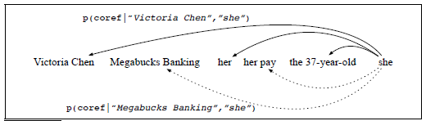
NATURAL LANGUAGE PROCESSING
Co-reference Resolution: Mention-pair Model
The mention-pair architecture is based around a classifier that is
given a pair of mentions,
a candidate anaphor and
a candidate antecedent,
and makes a binary classification decision: co-referring or not.
Early classifiers used hand-built features but more recent classifiers
use neural representation learning.
For each prior mention like Victoria Chen, Megabucks Banking, her, etc.,
the binary classifier computes a probability: whether or not the mention is the antecedent of ‘she’.
This probability should to be high for actual antecedents (Victoria Chen, her, the 38-year-old) and low for non-antecedents (Megabucks Banking, her pay).

Slide 24
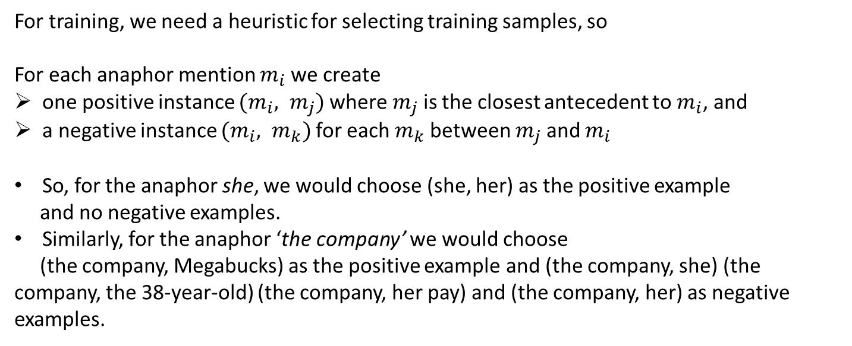
NATURAL LANGUAGE PROCESSING
Co-reference Resolution

Slide 25
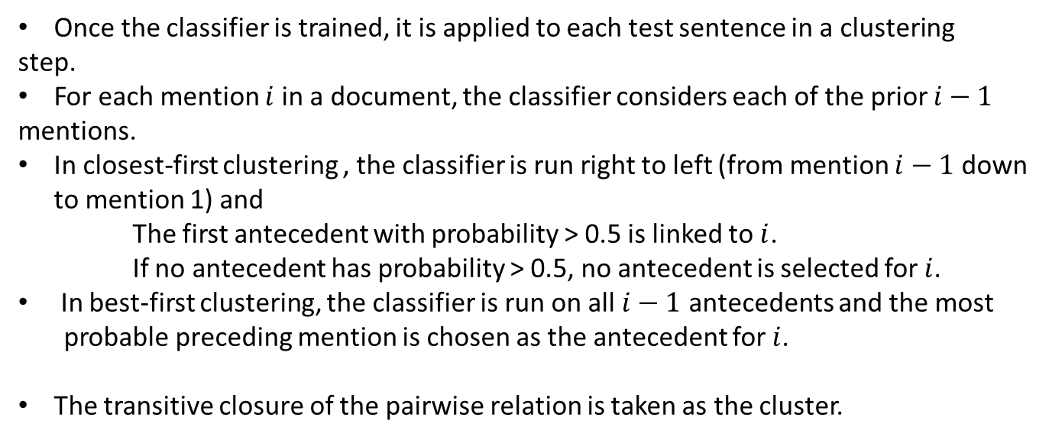
NATURAL LANGUAGE PROCESSING
Mention-pair Model

Slide 26
NATURAL LANGUAGE PROCESSING
2 main Problems of Mention-Pair Model
1. The classifier doesn’t directly compare candidate antecedents to each other, so it’s not trained to decide, between two likely antecedents, which one is in fact better.
2. It ignores the discourse model, looking only at mentions, not entities. Each classifier decision is made completely locally to the pair.(Each candidate antecedent is considered independently of the others)

Slide 27
NATURAL LANGUAGE PROCESSING
Mention-Ranking Model
Denis & Baldridge 2007, 2008
Imposes a ranking on a set of candidate antecedents
Strength
Considers all the candidate antecedents simultaneously
Weakness
Insuﬃcient information to make an informed coreference decision.

Slide 28
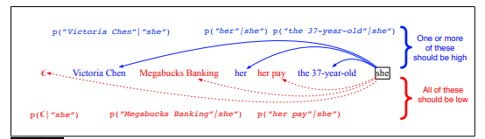
NATURAL LANGUAGE PROCESSING
Mention-Ranking Model
In early formulations, for mention i, the classifier decides which of the {1,...,i− 1} prior mentions is the antecedent.
But suppose i is in fact not anaphoric, and none of the antecedents should be chosen?
So in modern mention-ranking systems, for the ith mention (anaphor), we have an associated random variable yi ranging over the values
Y(i) = {1,...,i−1, ε}.
The value ε is a special dummy mention meaning that i does not have an antecedent (i.e., is either discourse-new and starts a new coref chain, or is non-anaphoric).
Once the antecedent is classified for each anaphor, transitive closure can be run over the pairwise decisions to get a complete clustering
For each candidate anaphoric mention (like she), the mention-ranking system assigns a probability distribution over all previous mentions plus the special dummy mention ε.

Slide 29


Slide 30
NATURAL LANGUAGE PROCESSING
Mention-Ranking Models
Mention-ranking models can be implemented with hand-build features or with neural representation learning

Slide 31
NATURAL LANGUAGE PROCESSING
Course References
Text Book:
1. “Introduction to Natural Language Processing”, Jacob Eisenstein, MIT Press, Adaptive computation and Machine Learning series, 18th October, 2019.
The open source softcopy is available at githubhttps://github.com/jacobeisenstein/gt-nlp class/blob/master/notes/eisenstein-nlp-notes.pdf.
Reference Books:
1: “Speech and Natural Language Processing”, Daniel Jurafsky and James H. Martin, 2nd edition paperback,2013.
The more up to date 3rd edition draft is available at http://web.stanford.edu/~jurafsky/slp3/

Slide 32
NATURAL LANGUAGE PROCESSING
Classifiers using hand-built features

Slide 33
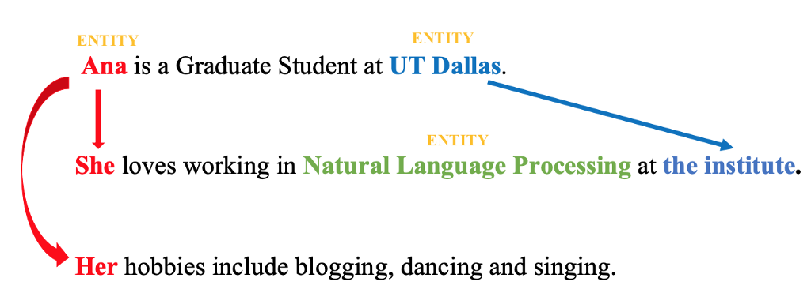
NATURAL LANGUAGE PROCESSING
Classifiers using hand-built features
Coreference resolution (CR) is the task of finding all linguistic expressions (called mentions) in a given text that refer to the same real-world entity.
Hand-designed features play an important role in coreference:
As the sole input to classification in pre-neural classifiers, or
As augmentations to the automatic representation learning used in state-of-the-art neural systems.

Slide 34
NATURAL LANGUAGE PROCESSING
Classifiers using hand-built features
Given an anaphor mention and a potential antecedent mention, most feature based classifiers make use of three types of features:
Features of the anaphor
Features of the candidate antecedent
Features of the relationship between the pair
Entity based models can make additional use of two classes:
Features of all mentions from the antecedent’s entity cluster
Features of the relation between the anaphor and the mentions in the antecedent entity cluster.

Slide 35
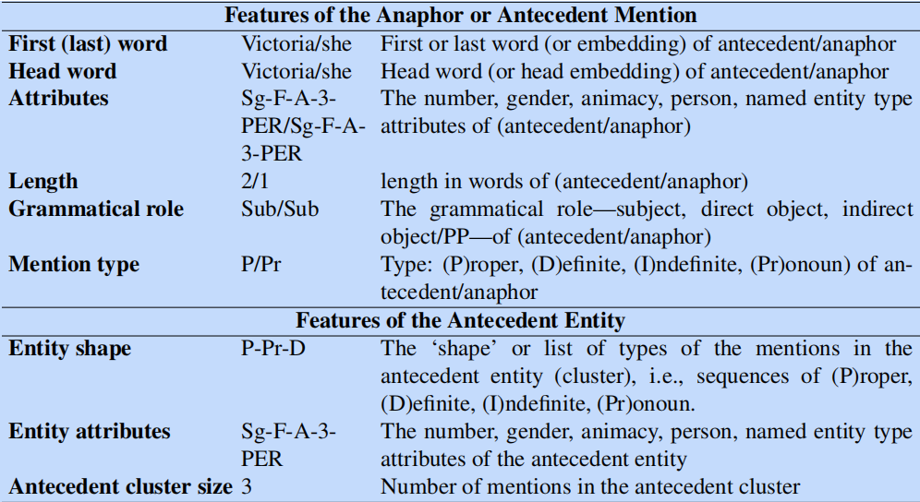
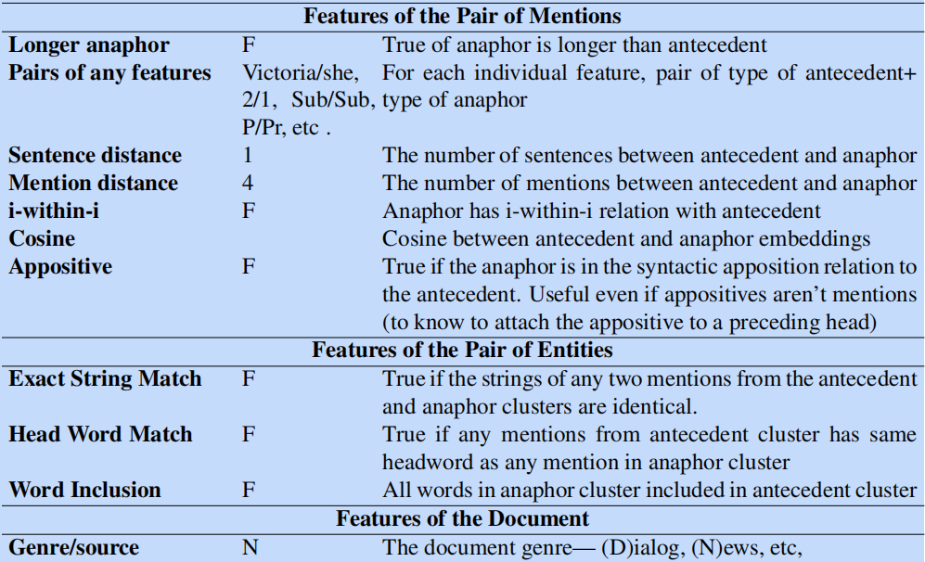
NATURAL LANGUAGE PROCESSING
Classifiers using hand-built features
Example: “Victoria Chen, CFO of Megabucks Banking, saw her pay jump to $2.3 million, as the 38-year-old also became the company’s president. It is
widely known that she came to Megabucks from rival Lotsabucks.”
Figure shows a selection of commonly used features, and shows the value that would be computed for the potential anaphor “she” and potential antecedent “Victoria Chen” in our example sentence.

Slide 36
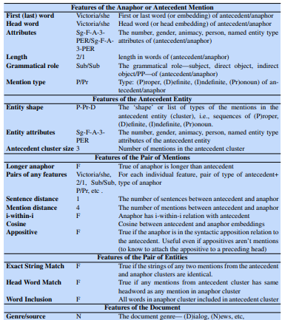
NATURAL LANGUAGE PROCESSING
Co-reference Resolution
This Figure shows a selection of commonly used features, and shows the value that would be computed for the potential anaphor “she” and potential antecedent “Victoria Chen” in our example sentence.

Slide 37
NATURAL LANGUAGE PROCESSING
Classifiers using hand-built features
Features that prior work has found to be particularly useful are exact string match, entity headword agreement, mention distance, as well as (for pronouns) exact attribute match and i-within-i, and (for nominals and proper names) word inclusion and cosine.
For lexical features (like head words) it is common to only use words that appear enough times (perhaps more than 20 times), backing off to parts of speech for rare words.

Slide 38
NATURAL LANGUAGE PROCESSING
Classifiers using hand-built features
It is crucial in feature-based systems to use conjunctions of features; an experiment suggested that moving from individual features in a classifier to conjunctions of multiple features increased F1 score by 4 points.
Specific conjunctions can be designed by hand, all features can be conjoined or feature conjunctions can be learned using decision tree or random forest classifiers.

Slide 39
NATURAL LANGUAGE PROCESSING
Classifiers using hand-built features
Some of these features can be used in neural models as well.
Modern neural system use contextual word embeddings, so they don’t benefit from adding shallow features like string or head match, grammatical role, or mention types.
However, other features like mention length, distance between mentions or genre can complement neural contextual embedding models nicely.

Slide 40
NATURAL LANGUAGE PROCESSING
Course References
1. “Speech and Natural Language Processing”, Daniel Jurafsky and James H. Martin, 2nd edition paperback,2013.
The more up to date 3rd edition draft is available at http://web.stanford.edu/~jurafsky/slp3/
2. “Introduction to Natural Language Processing”, Jacob Eisenstein, MIT Press, Adaptive computation and Machine Learning series, 18th October, 2019.
The open source softcopy is available at githubhttps://github.com/jacobeisenstein/gt-nlp class/blob/master/notes/eisenstein-nlp-notes.pdf.
(Discourse is completely from 2)

